Slide 1
LifeLineVR
The Importance of Red Blood Cells in
the Human Body
[Group 6]
Russell Lim
Toh Jing Qiang
Ding Wen

Slide 2
01
Motivation (Recap)
Importance of red cells in the body
Importance of constant blood donation

Slide 3
Motivation (Recap) - Educational Challenges
A. Importance of red blood cells in the body
B. Importance of Constant Blood Donation
Red Blood cells transport oxygen from our lungs to our body’s tissues where they are used to produce energy needed to sustain the bodily functions (Cleveland Clinic Medical, 2025)
While this may be taught, it is difficult to visualise the processes and thus, understand their crucialness without aid.
While most people are aware of the importance of blood donation to save peoples’ lives in a medical emergency, they often overlook the constant need for blood donation due to shortages and limited storage period.
Red blood cells last about 42 days in storage (American Red Cross, n.d.).

Slide 4
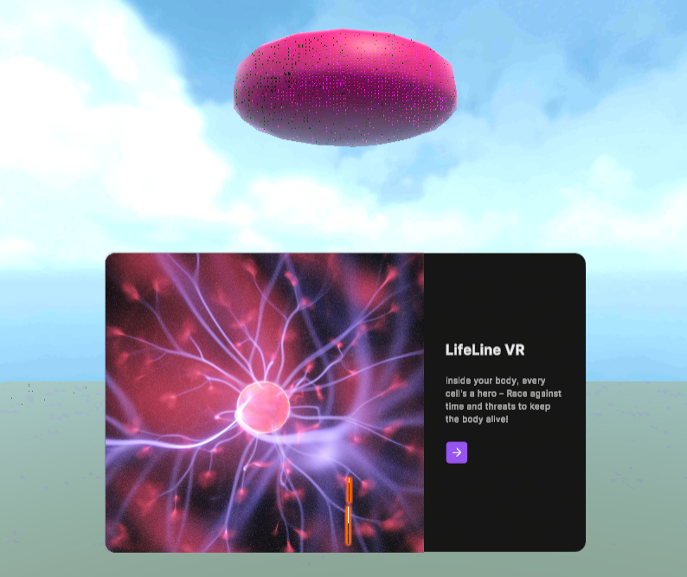
02
LifeLine VR
Inside your body, every cell's a hero – Race against time and threats to keep the body alive!

Slide 5
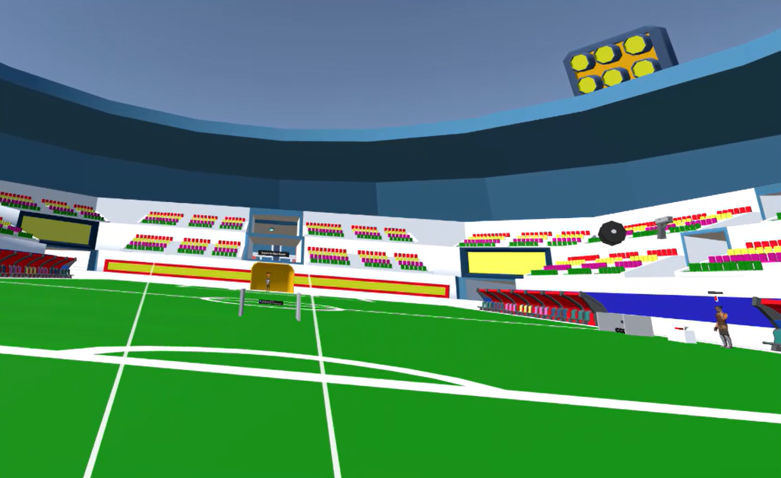
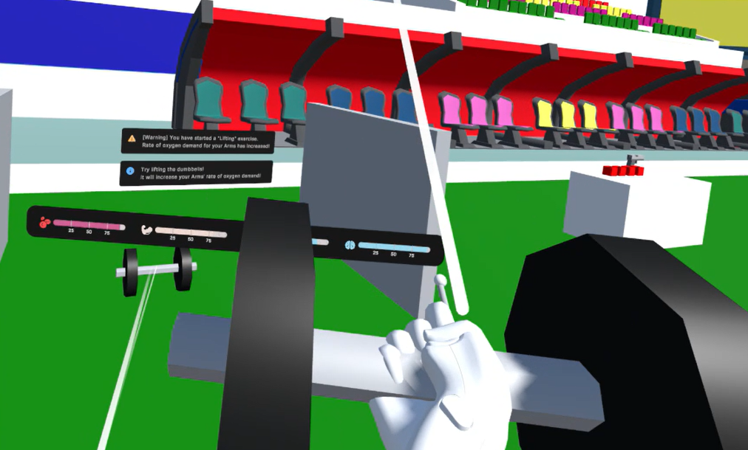
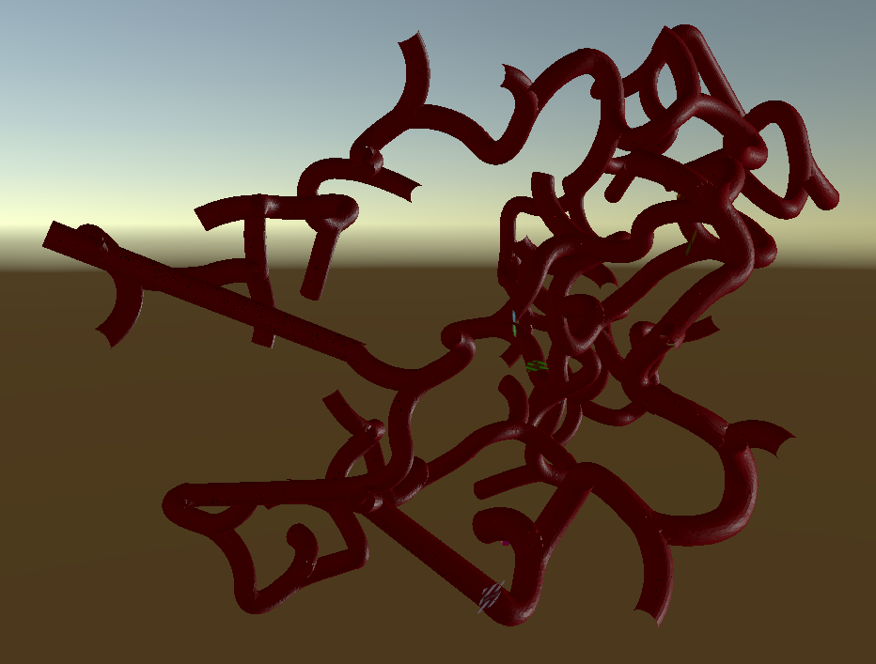
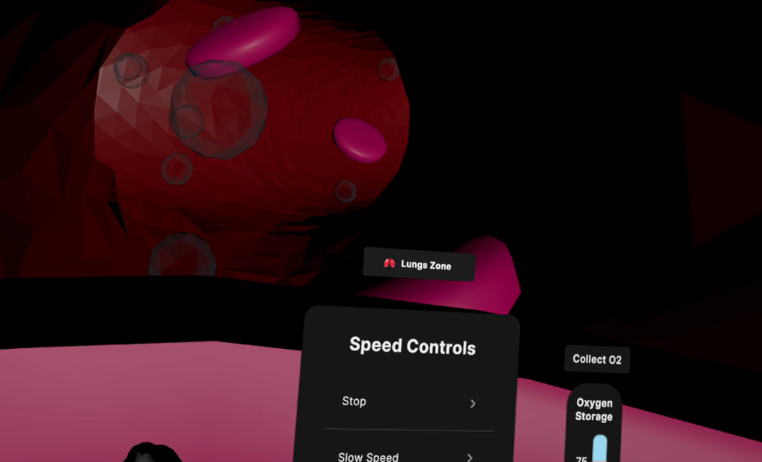
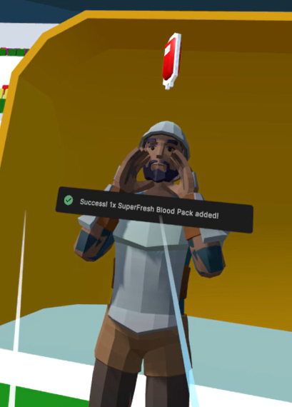
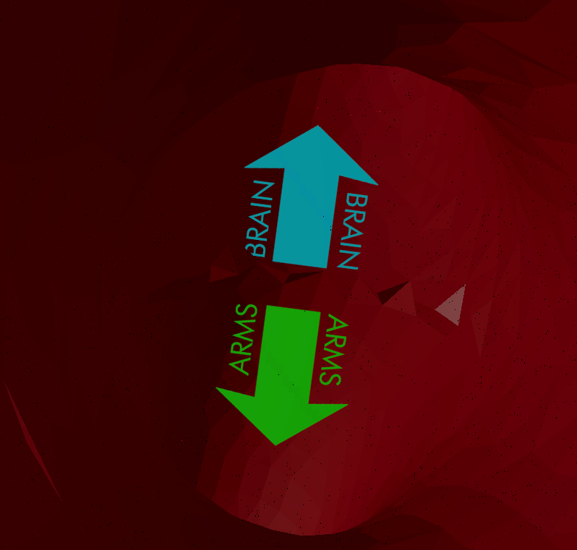
[Scaling Space] The 2 Game Modes!
(1) Human Mode
Spatial Element and Manipulation of Scale!
(2) Red Blood Cell Mode
Players can interact with the human environment.
(human level)
Players control a Red Blood Cell ship and interact with the bloodstream environment (microscopic level)

Slide 6

[Scaling Time] Red blood cells in body decrease over time!
Temporal Element
As the player plays the game, the percentage of red blood cells in the body will decrease gradually, with major spikes in the amount decreased every 14 mins.
*Each playtime minute equals 10 real-world days.

Slide 7
Player’s Goal
The player’s goal in the game is to survive while doing different activities in the Human mode that affects the body’s oxygen demand, and switching to the Red Blood Cell mode to increase the oxygen levels in the various body parts by transporting oxygen themselves.
Ultimately, the player should keep their red blood cells levels and oxygen levels above 0 throughout the game.

Slide 8
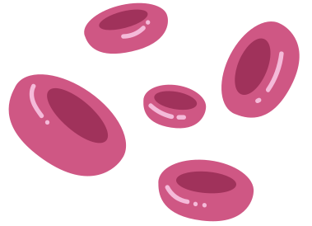

Game Video Trailer

Slide 9
03
Game Features & Implementation

Slide 10
Oxygen and Red Blood Cells Levels
Game Features & Implementation

Slide 11




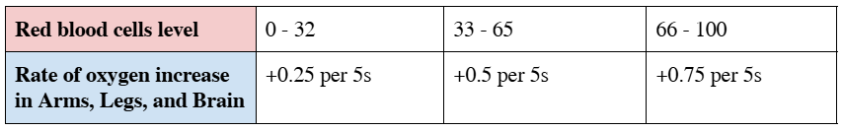
Oxygen and Red Blood Cells Levels
Oxygen and Red Blood Cells Levels
Lifeline VR tracks 2 important resources, Oxygen and Red Blood Cells
> Oxygen
> Red Blood Cells
Required by Virtual Body’s Arms, Legs, and Brain to survive, with a default rate of oxygen demand of -1.0 per 5s
RBC Level decrease gradually over time (-0.5 per 5s), with major spikes in the amount decreased every 14 mins (between -15 to -30 per 14mins).
Controls the rate of increase of oxygen.

Slide 12
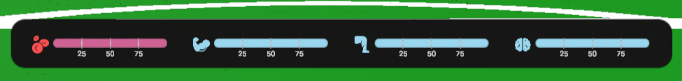




Oxygen and Red Blood Cells Levels
Oxygen and Red Blood Cells Levels
> Monitoring Oxygen and Red Blood Cells Levels
Players can monitor their oxygen and RBC levels via a UI panel that follows them around
> Alert Notification
When levels fall below half, an alert will be shown to the player to warn the player

Slide 13
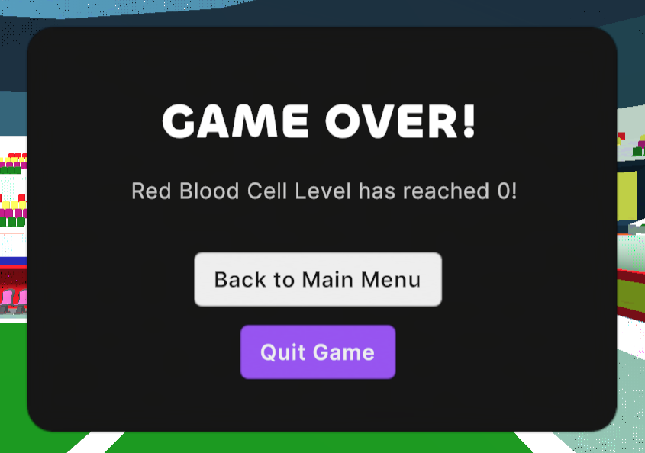
Oxygen and Red Blood Cells Levels
Oxygen and Red Blood Cells Levels
> GAME OVER
The game is over if any of the levels reaches 0!

Slide 14
Human Mode
Game Features & Implementation

Slide 15
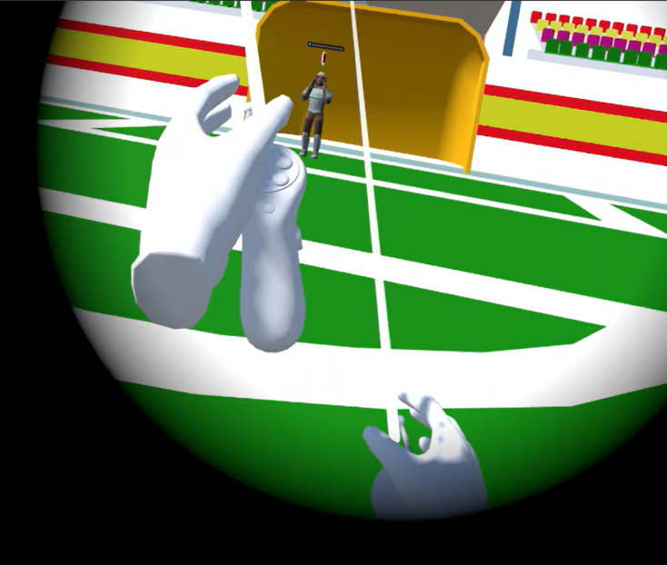
Performing Human Activities in Virtual Football Stadium Environment
Human Mode
In the Human mode scene, the player can move around and interact with the virtual football stadium environment in a first-person perspective.
Activities
Walking
Running
Lifting Dumbbell
Etc…

Slide 16
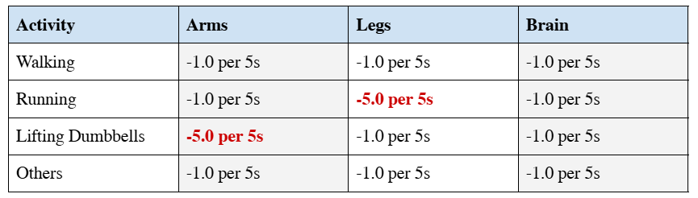
Impact of Human Activities on Rate of Oxygen Demand
Human Mode
Different activities will affect the rate of oxygen demand for different body parts (Arms, Legs, and Brain), replicating how human bodies work in real life.

Slide 17
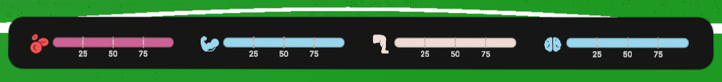
Updates to Oxygen Levels Panel UI
Human Mode
Visual feedback in terms of an update to the Oxygen Levels Panel UI is introduced to let the player know that the rate of oxygen demand for the Arms / Legs has increased.
For example, when running, the legs icon and bar will turn yellow to indicate that the rate of oxygen demand for the legs has increased. This enhances the game experience

Slide 18
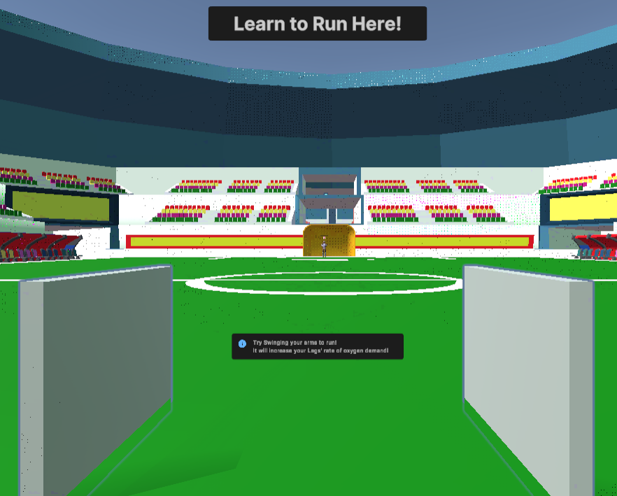
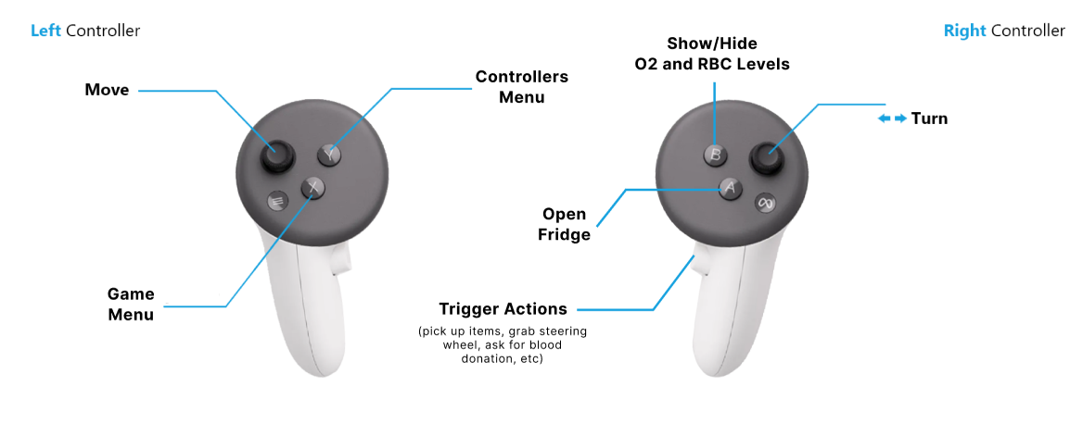
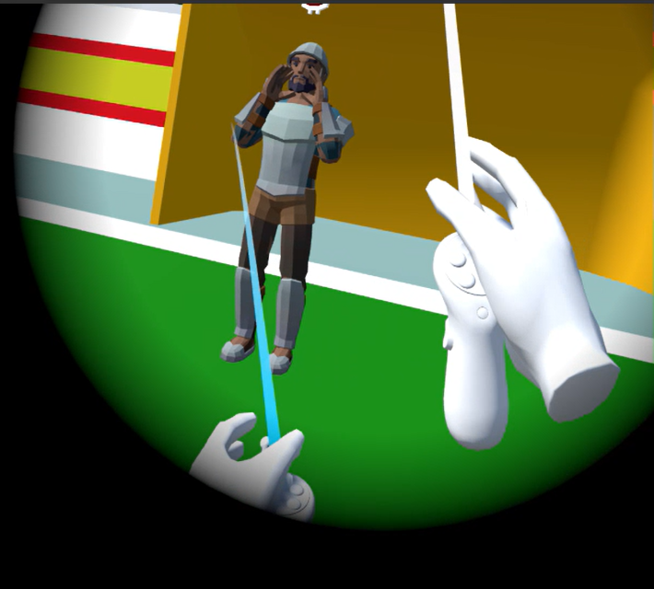
Human Activity – Running
Human Mode
To run, the player physically swinging their arms (with the controllers) up and down continuously while pointing the Left Controller’s joystick forward
Start/Stop Running Logic
For the player to be considered running, the player must continuously swing their arms for at least 1.5 seconds.
And similarly, the player must stop swinging their arms for at least 1.5 seconds to be considered not running anymore.
This method of implementation is to buffer for short periods of non-swinging motions, as well as to mimic the real-world where it takes a while for a human to start/stop running.
To minimize motion sickness, a Tunneling Vignette is applied when the player is running.

Slide 19
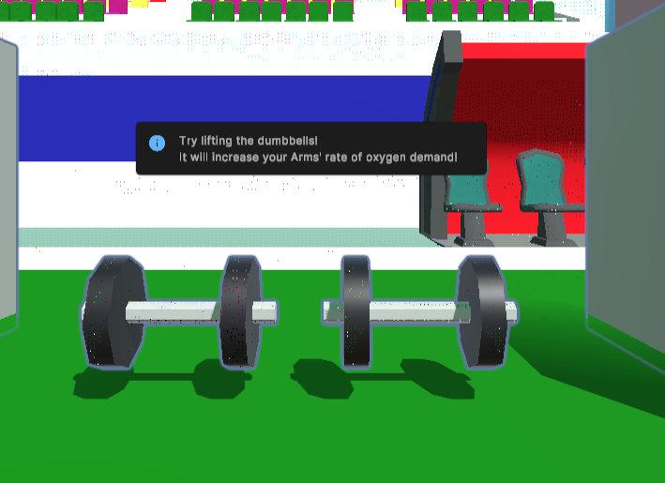
Human Activity – Lifting Dumbbells
Human Mode
To lift the dumbbells, the player needs to point the directional rays at the dumbbell and press the Right Controller’s trigger button.

Slide 20
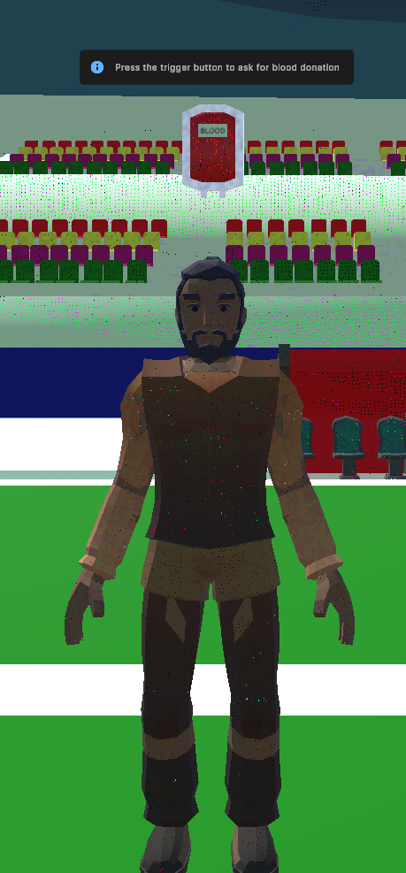
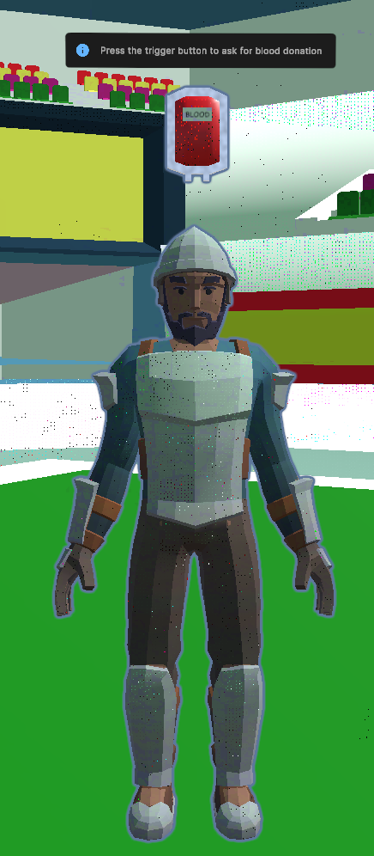
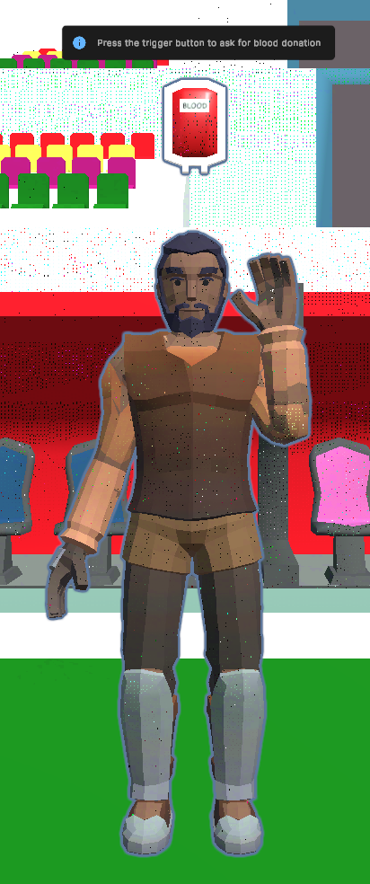
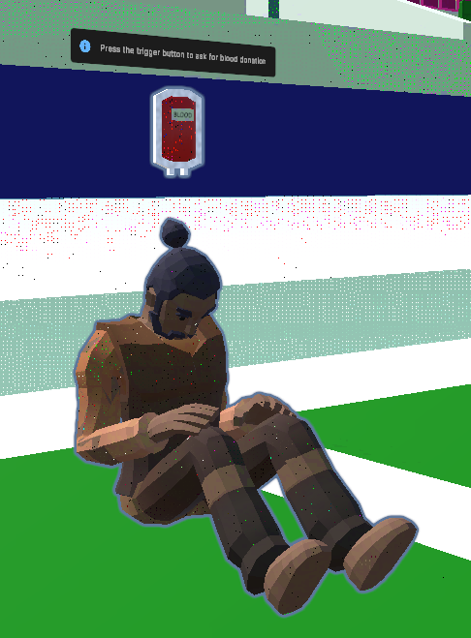
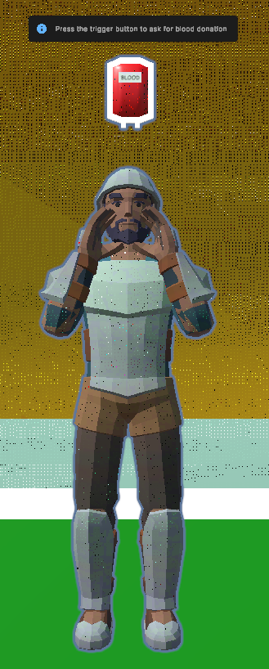
Human Activity – Blood Donation
Human Mode
(a) Human NPCs
As the red blood cells level decreases overtime, in order to maintain a safe level of red blood cells in the body, the player will need to find blood packs by encouraging Human NPCs (Non-Player Characters) to donate their blood by clicking on the Right Controller’s trigger button.
There are 5 NPCs in the game scattered around the stadium, and each NPC has different outfits and poses to add variation.

Slide 21
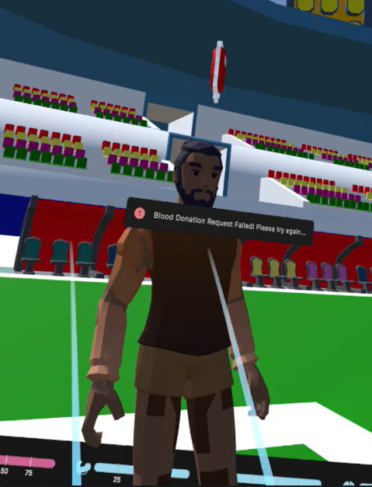
Human Activity – Blood Donation
Human Mode
(b) Blood Donation Success Probability
Each NPC will donate their blood with a different random chance (0.2, 0.4, 0.5, 0.6, 0.8).
Each NPC’s successful or failed attempt will result in a corresponding notification and there is a cooldown of 3s before the player can ask for blood donation from the same NPC again.

Slide 22
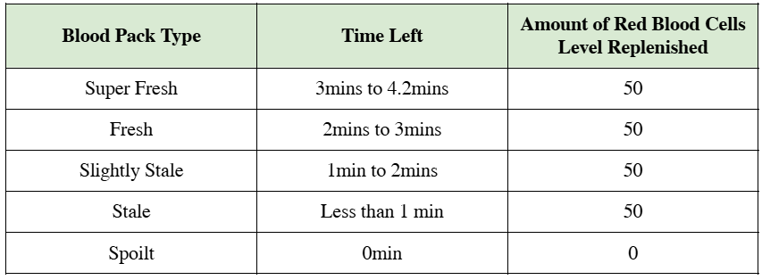
Human Activity – Blood Donation
Human Mode
(c) Blood Packs
A successful blood donation request will add 1x blood pack to the player’s fridge inventory, and it can only last for 4.2 minutes before it becomes unusable.
Each blood pack can be used to restore 50 red blood cell levels.
Blood Pack Types
To simulate the perishable nature of blood in blood packs, blood packs are categorized into one of five different states according to the time left before that blood pack becomes unusable. Spoilt blood packs cannot be used.
Each blood pack obtained from a Human NPC will start off in the “Super Fresh” state.

Slide 23
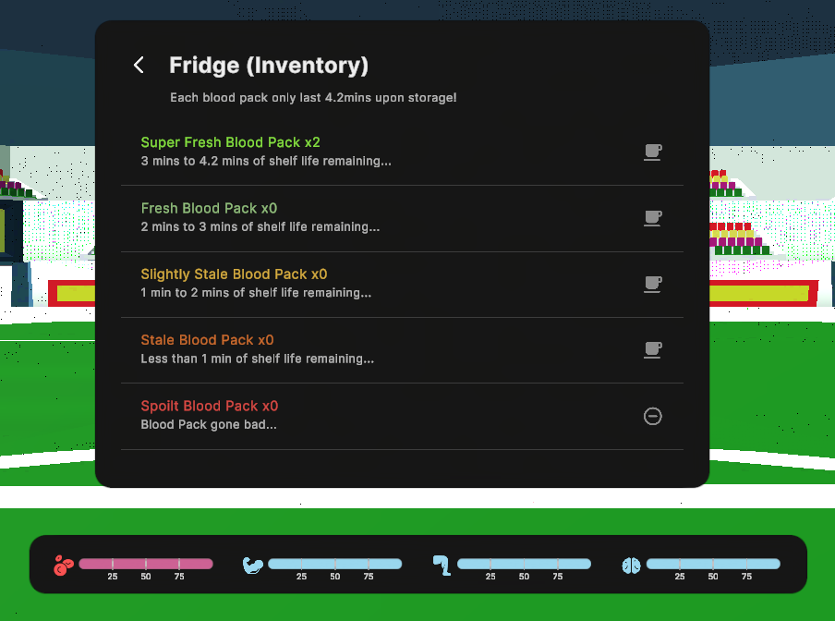
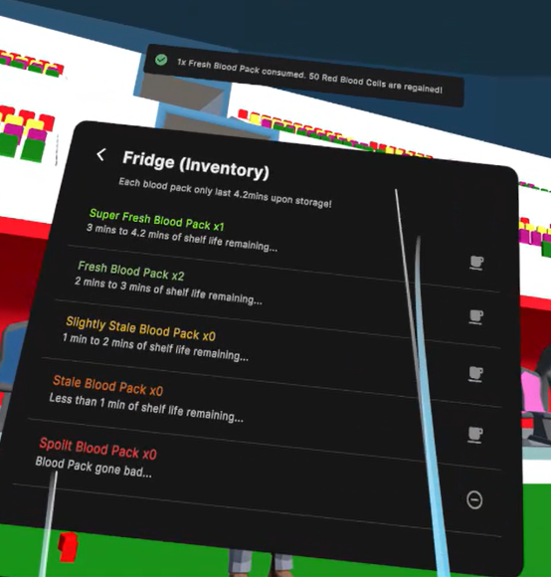
Human Activity – Blood Donation
Human Mode
(d) Fridge Inventory
All the blood packs obtained by the player can be accessed in their fridge inventory.
Blood packs can be used by clicking on the “Cup” icon and Spoilt blood packs can be discarded by clicking on the “-” icon.
Consuming a blood pack will notify the player that the blood pack has been consumed and 50 red blood cells levels have been restored.
The player will start the game with 2 SuperFresh Blood Packs in their fridge.

Slide 24
Red Blood Cell Mode
Game Features & Implementation

Slide 25
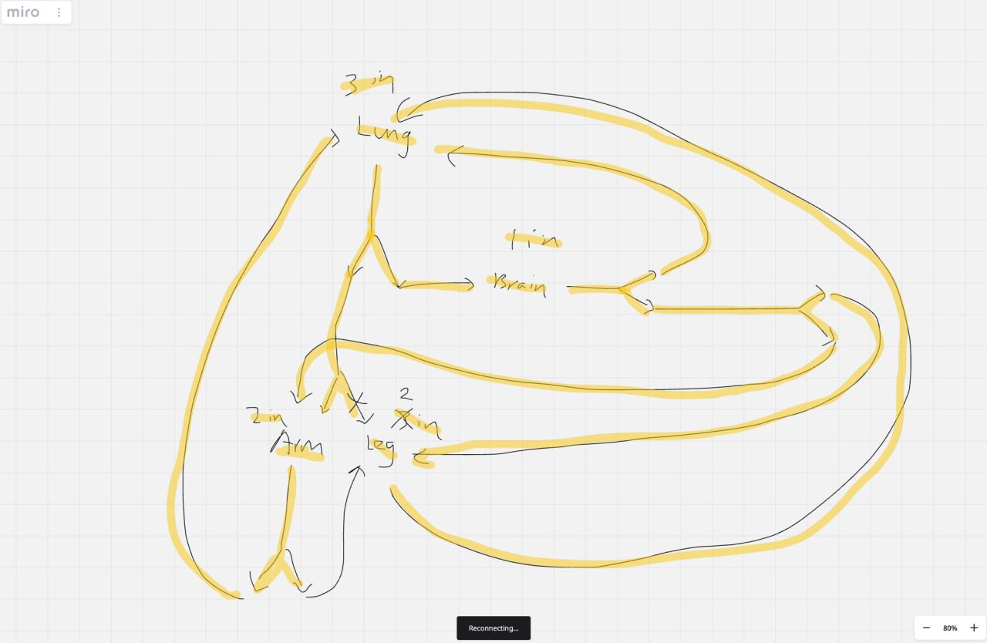
Bloodstream Environment
Red Blood Cell Mode
(a) The Environment Map – Bloodstream
The scene is set in the bloodstream environment, with 4 major body tissues – Arms, Legs, Brain, and Lungs. Each body tissue is linked together via a set of blood vessels that forms the environment.
To enhance gameplay interaction and immersiveness through movement potential, we made the bloodstream layout such that there are different paths that the player can take to move from one point to another, and that the paths can go in any direction in three-dimensional space.
Sketch of map
Unity Implementation of map
Player’s Perspective

Slide 26




Bloodstream Environment
Red Blood Cell Mode
(b) Major Body Tissue Zones
The 4 major body tissue zones are marked in the environment.
Rules
Oxygen can only be collected in the Lungs,
and can only be deposited in the Arms, Legs, and Brain.
The player’s current zone is tracked.

Slide 27
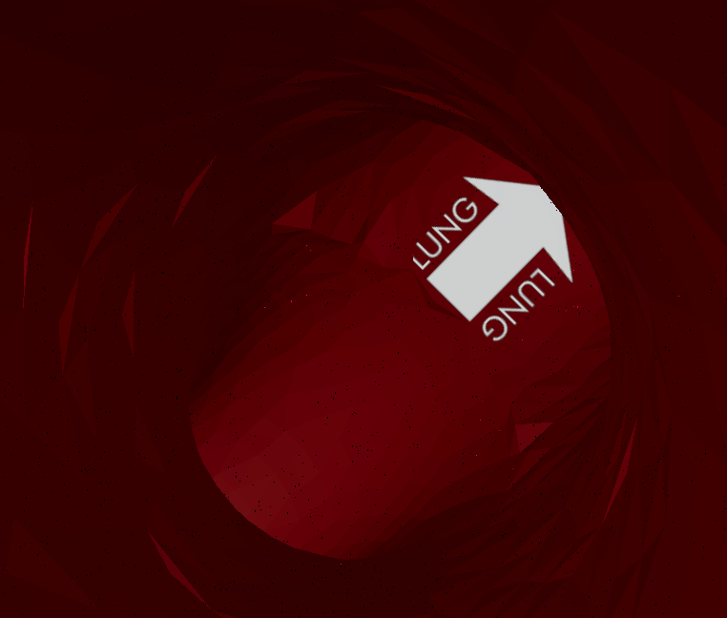
Bloodstream Environment
Red Blood Cell Mode
(c) Direction Signs
To let the player know where they are going, direction signs are added to the bloodstream.

Slide 28
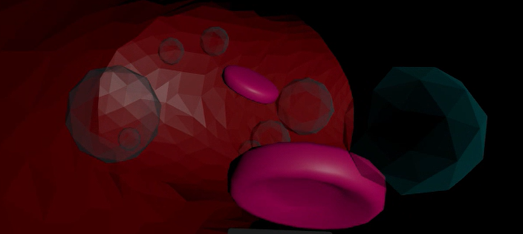
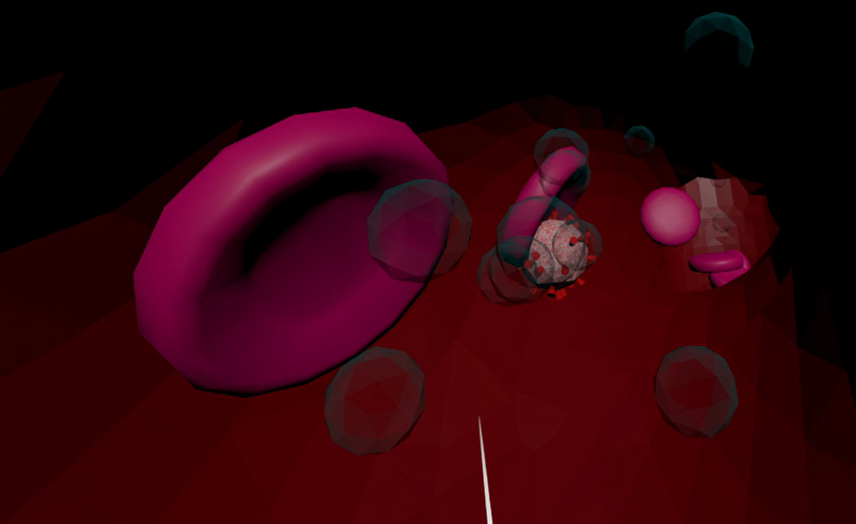
Bloodstream Environment
Red Blood Cell Mode
(d) NPC Generation
NPC Entities, including Red Blood Cells, White Blood Cells, Virus Cells, and Oxygen, are automatically generated and populated into the scene via our custom NPC Spawner script.
Spawned NPCs will flow in the bloodstream in a forward direction, following a Brownian motion to make it more realistic.
Oxygen NPCs will only be spawned in the Lungs zone and they will stay in that zone, ignoring forward motion.

Slide 29
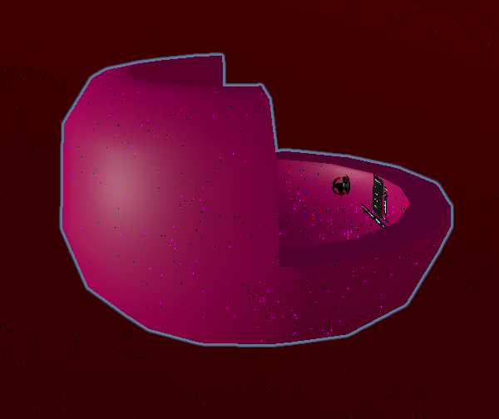
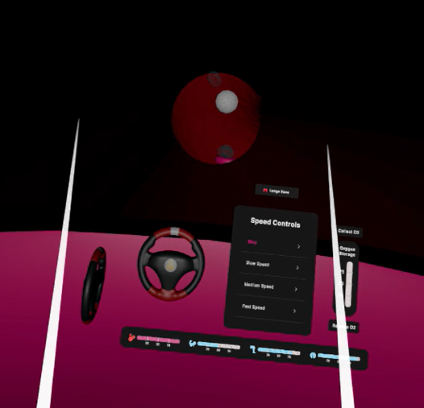
Red Blood Cell Ship – Player
Red Blood Cell Mode
(a) Player Perspective
In the red blood cell mode, the player will be in first-person perspective in a red-blood-cell-like ship inside the bloodstream to make the experience more immersive.
Left: Red Blood Cell Ship; Right: Player’s perspective inside the ship

Slide 30
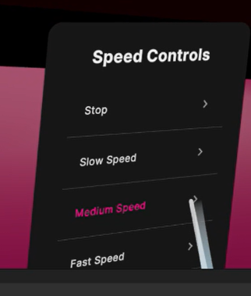
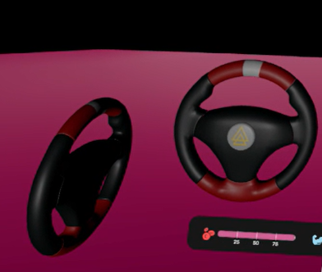
Red Blood Cell Ship – Player
Red Blood Cell Mode
(b) Ship Movements and Controls
> Forward Movement
The ship can only move forward, just like how blood flows in one way.
The player can control the speed of the ship’s forward movement via the Speed Controls Panel. There are 4 speed options – Stop, Slow, Medium, and Fast.
> Yaw and Pitch Controls
The player can control the Yaw and Pitch of the ship via the 2 steering wheels.
The player can only turn the ship a maximum of 45 degrees in either direction, and some angular friction is added to make the controls more realistic.
These Yaw and Pitch Controls allow the player to have more freedom in moving inside the bloodstream and when choosing which direction to go at path forks.

Slide 31
Red Blood Cell Ship – Player
Red Blood Cell Mode
(b) Ship Movements and Controls
> Auto-steering
As the bloodstream paths go in various directions, we implemented an auto-steering feature that automatically steers the ship in the correct direction and angle so that the player moves in the correct direction and can see what is in front of the ship.
This is achieved by nudging the ship towards the end of the nearest path segments whenever necessary.
This enhances the gameplay and accessibility significantly as the player does not need to constantly steer the ship while possibly getting used to virtual reality.

Slide 32
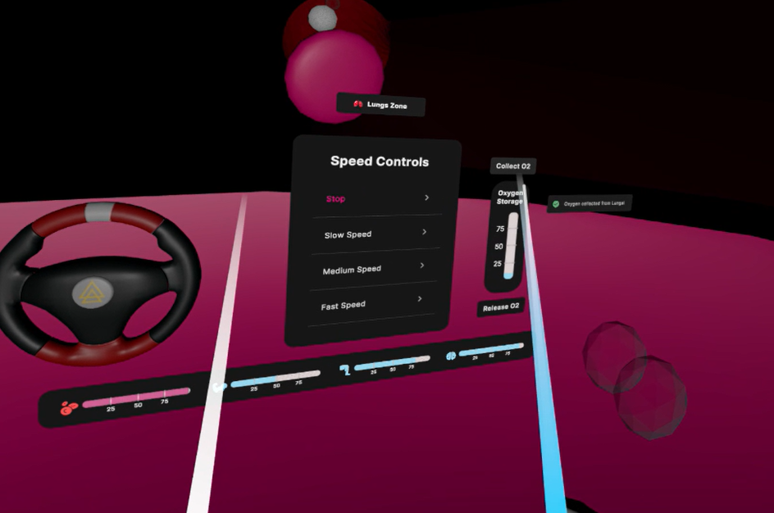
Red Blood Cell Ship – Player
Red Blood Cell Mode
(c) Collecting and Depositing Oxygen
The player can collect and deposit oxygen by clicking on the corresponding buttons in the ship.
When oxygen has been collected in the Lungs Zone, “Oxygen Balls” will be added to the ship and the “Oxygen Storage” gauge will begin to top up.
On the other hand, when oxygen is deposited in the Arms/Legs/Brain Zone, “Oxygen Balls” will be removed from the ship and the “Oxygen Storage” gauge will drop. At the same time, the oxygen level in the corresponding zone’s body part will increase.
A maximum of 100 oxygen levels can be collected and stored in the “Oxygen Storage”, and each oxygen ball contains 5 oxygen levels.

Slide 33
Adjustable Parameters
Game Features & Implementation

Slide 34
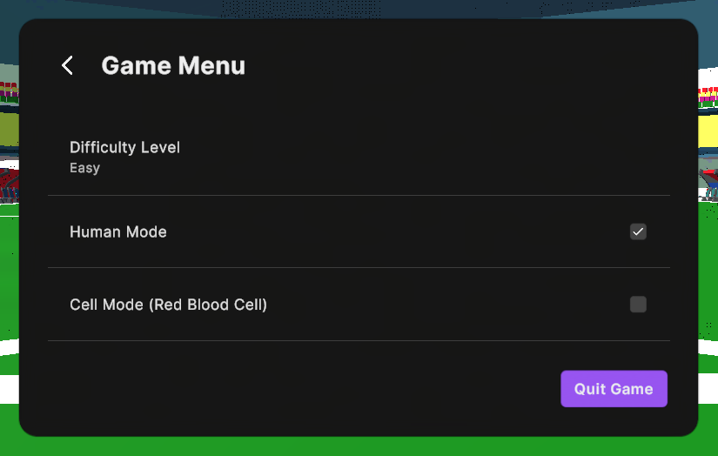
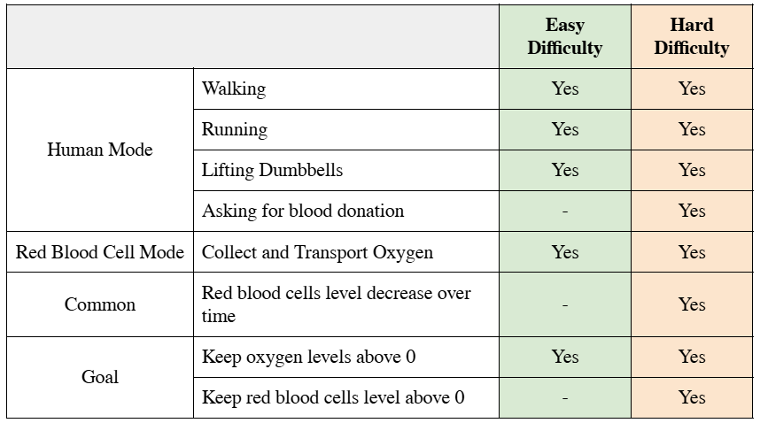
Game Menu
(a) Adjusting Player’s Perspective – The 2 Game Modes
The player can adjust their perspective between a Human and a Red Blood Cell easily via a click of a User Interface button
(b) Adjusting Game Difficulty Levels
To make the game more beginner friendly, 2 difficulty levels are introduced:
Easy Difficulty
Hard Difficulty

Slide 35
04
Tools & Frameworks + Key Assets

Slide 36

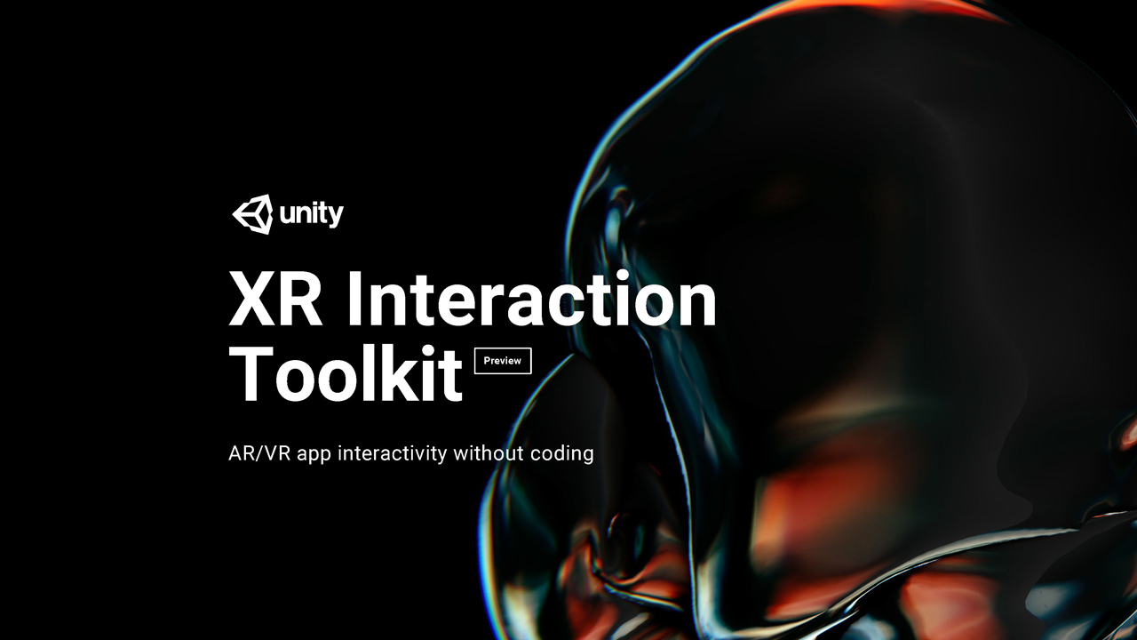

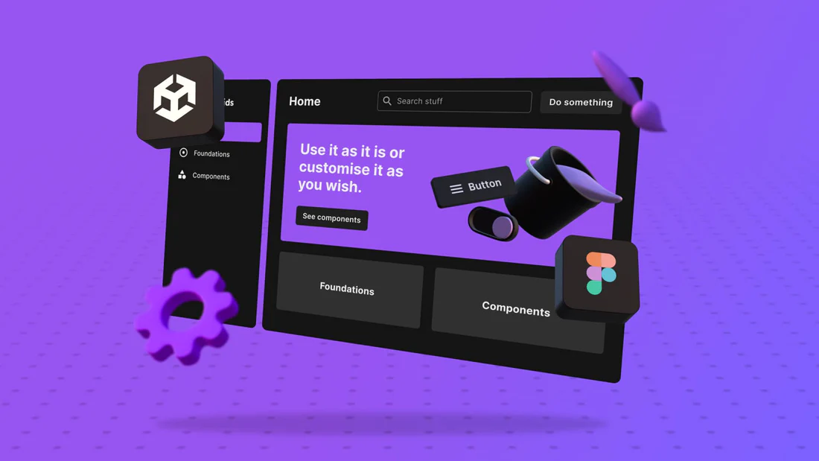

Tools & Frameworks
UI Wireframing
Modelling Custom
3D models
VR Interactions
Version control and remote collaboration
VR UI Components Library

Slide 37
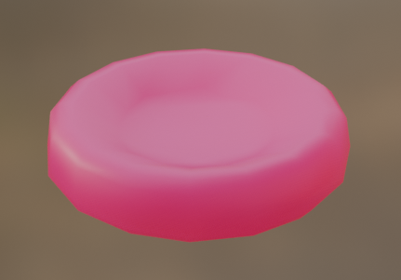
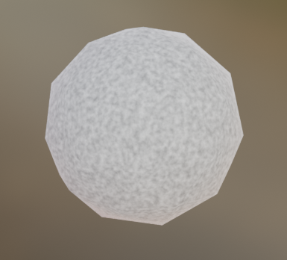
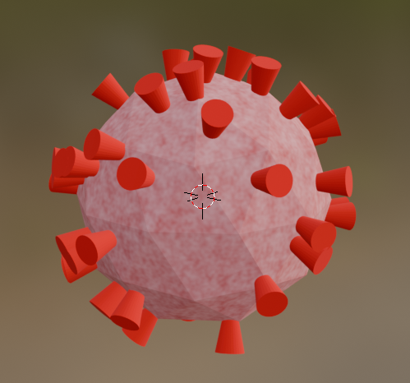
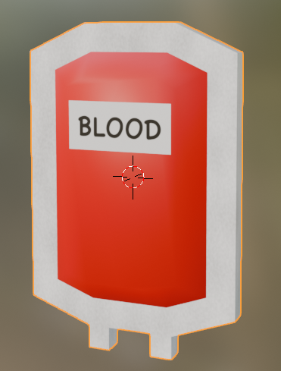
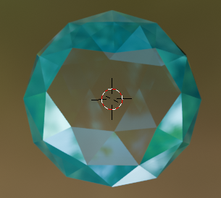
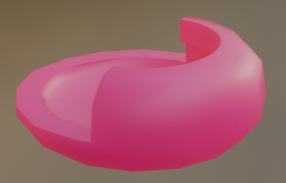
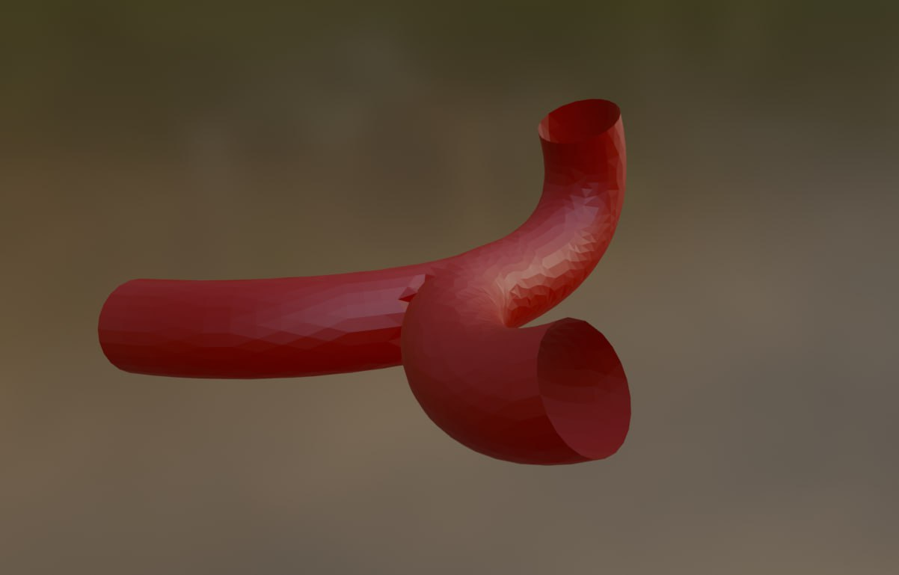
Tools & Frameworks – Blender
We created these custom 3D models!
Red Blood Cell
White Blood Cell
Virus Cell
Blood Pack
Red Blood Cell Ship
Blood Vessel
Oxygen Ball

Slide 38
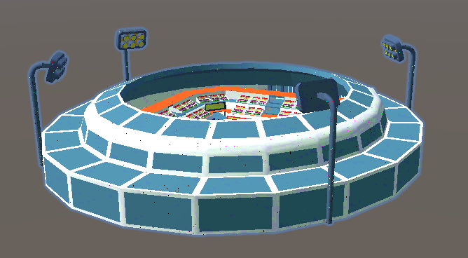
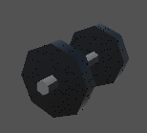
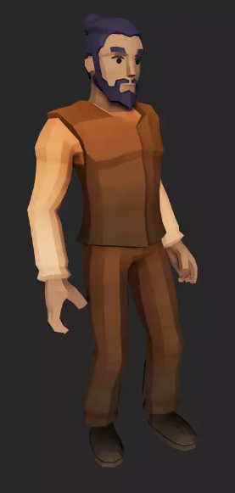

Key Assets Imported
Stadium
Dumbbell
Human
Steering Wheel

Slide 39
05
Members Contributions

Slide 40
Members’ Contributions
Name | Role | Contributions
Toh Jing Qiang | VR Simulation Idea Director Report Writer Unity Developer | User Interfaces Game Logic for Human and RBC Modes Human Mode Human Mechanics Dumbbell, Running, Blood Donation Red Blood Cell Mode Red Blood Cell Ship and Controls
Russell LIm | Report Writer Unity Developer | Human Mode Human Mechanics Pistol, Dumbbell, Running, Blood Donation
Ding Wen | Asset Modeller Unity Developer | Asset Modelling (Unity) Red Blood Cell Mode Bloodstream Map generation Ship Auto-steering NPCs generation and path movements Etc…

Slide 41
06
Conclusion

Slide 42
Challenges
1. Implementing Auto-steering of Red Blood Cell Ship
We faced challenges in implementing the auto-steering feature of the Red Blood Cell Ship as the bloodstream paths were generally windy in the third dimension, and the representations of the paths were discrete. However, discrete movements may feel unrealistic and induce motion sickness in the player.
To solve this challenge, we
first implemented a foundational realistic physics model for the ship.
The auto-steering is then implemented by applying forces on the ship, creating realistic and smooth movement.
To smoothen out the discrete changes in the path segments, a smooth damp function was used to interpolate between path segments when it changes.
To deal with late-turning due to this, path segments end early (before the player reaches the end of each segment), except in the case of forked paths.

Slide 43
Challenges
2. Creating The Bloodstream Map
We faced challenges in creating the three-dimension bloodstream map, due to its spatial complexity.
To solve this challenge, we created an editor tool that allowed the next path to be created, conjoined to the end of the current path, at a user-specified angle.
The main path model that was used was a blood vessel that splits into two. This worked naturally as a splitting path. However, we also required merging paths; this was done by reversing the split-path model.
The main challenge was in connecting two unrelated paths together from a distance. This required a liberal use of merging paths – which doubled up as a "straight" path if one of the inputs were left unconnected – as well as actual straight paths, which was used to connect paths together in a suboptimal but usable manner when close together.

Slide 44
Challenges
3. Only 1 Meta Quest Headset Available
As there was only 1 Meta Quest Headset available for use per team, we faced challenges during our development phase as our members lived far from one another and we needed the headset frequently to test the interactable features.
We solved this challenge by assigning the headset to one member, and through constant and clear communication between members, we coordinated the development and testing of the implemented features overtime.

Slide 45
Ideas for Future Improvement
Adding More Physical Activities
Multiplayer Mode
Enhanced Human NPC Interaction
Narrative Expansion
Adding Audio

Slide 46
THANK YOU

